Slide 1
IETF Hackathon: SD-WAN service model Mapping
IETF 103
3-4 Nov, 2018
Bangkok

Slide 2
Hackathon Plan
Verify the dynamic setup, update and deletion of SD-WAN VPN connection using ONAP orchestrator platform
draft-sun-opsawg-sdwan-service-model-00
Open Source ONAP Components
SDN-C (Opendaylight, SLI, My SQL etc. )
Node-Red based Directed graph(DG)
POSTMAN based Model API

Slide 3



SD-WAN Service Creation and modification
Verify SD-WAN service YANG to create a SD-WAN VPN service
ONAP orchestrator includes service orchestrator(SO) and
SDN-C( Multi domain controller)
Participating components
Service Configuration API
ONAP SDN-C
SD-WAN controller
Physical CE，virtual CE
Customer Model based API
ONAP SDN-C
(orchestrator)
Mgmt network
Underlay network
SD-WAN Network API
Data link
SD-WAN controller
(Domain Controller)
SD-WAN VPN connection
Device Model
RESTful API
RESTFul API/RESTCONF/YANG
SiteA
CE
Underlay Network
CE
SiteB
Notes:
No need to define the SD-WAN standard interface of third party controller with ONAP？
Then what should be standardized?
Customer model needs to be standardized?

Slide 4
SD-WAN VPN model Mapping
SD-WAN model design and deployment
Base on the design of the model and DG(Directed Graph), SDNC performs the multi-domain orchestration and request the domain controller to create an overlay VPN.
Customer service model
Customer input service
Parameters based on the model
Site list
SD-WAN
VPN list
SD-WAN VPN Attachment
Resource model
SD-WAN VPN Attachment
Each node in resource
Model decompose into Restconf API
LAN
Site
WAN
SD-WAN
Connectivity
WAN
Site
LAN
CE
CE
IETF topology model?
Resource @ CE
（YANG）
Resource @ CE
（YANG）
VXLAN
IPSEC
IPSEC
TUNNEL
VXLAN
Device model
SITEA
uCE
SITEB
vCE

Slide 5
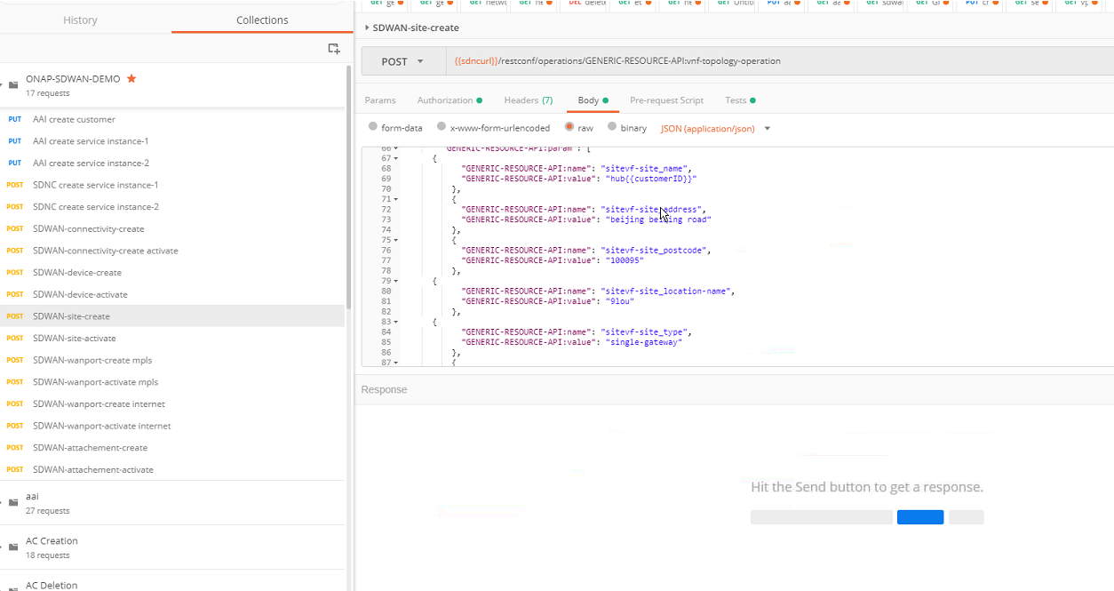
SD-WAN ONAP SDN-C(network orchestrator ) Northbound interface API

Slide 6
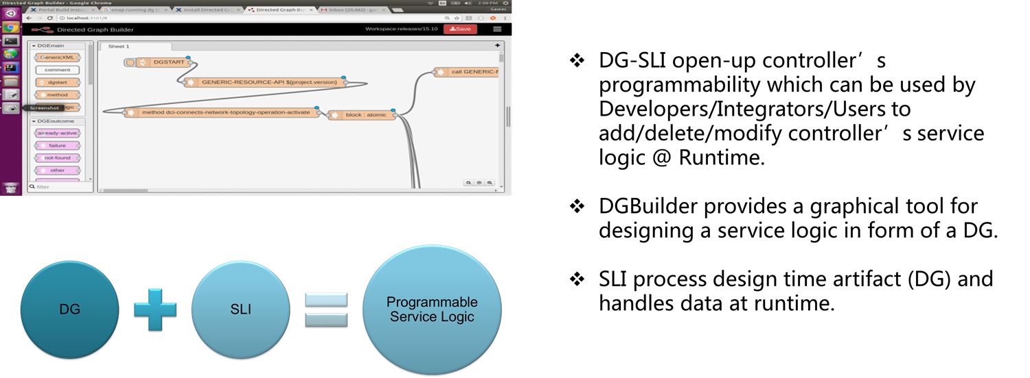
SD-WAN service modification
Verify that the ONAP can modify the established service upon requirement changes by using DG
DG
Design
Notes:
No need to define the SD-WAN standard interface of third party controller with ONAP？
Then what should be standardized?
Customer model needs to be standardized?
what is the interface of the two controllers will look like ？ why yang interface needed?

Slide 7
What got done
Achievements – Implementation Team
ONAP SD-WAN service creation and modification
POSTMAN API

Slide 8
What we learned
APIs are derived from Service Model
Service Model mapping is the key to automation.
Open Source tools provide lifecycle management of Model and APIs.
Listen to feedback on modelling Problem from OpenSource developers.
Notes:
roll back mechanism

Slide 9
The hackers team
Team members –
Shashikanth V H
Gaurav Agrawal (remote only)
Zhou Jun
Wu Qin
Wu Bo
Sun Qiong(remote only from China Telecom)

Slide 10
Thank you
SD-WAN service development team (Shashikanth V H and others)
Charles Eckel & Barry Leiba
OpenSource developers who collaborated with us

Slide 11

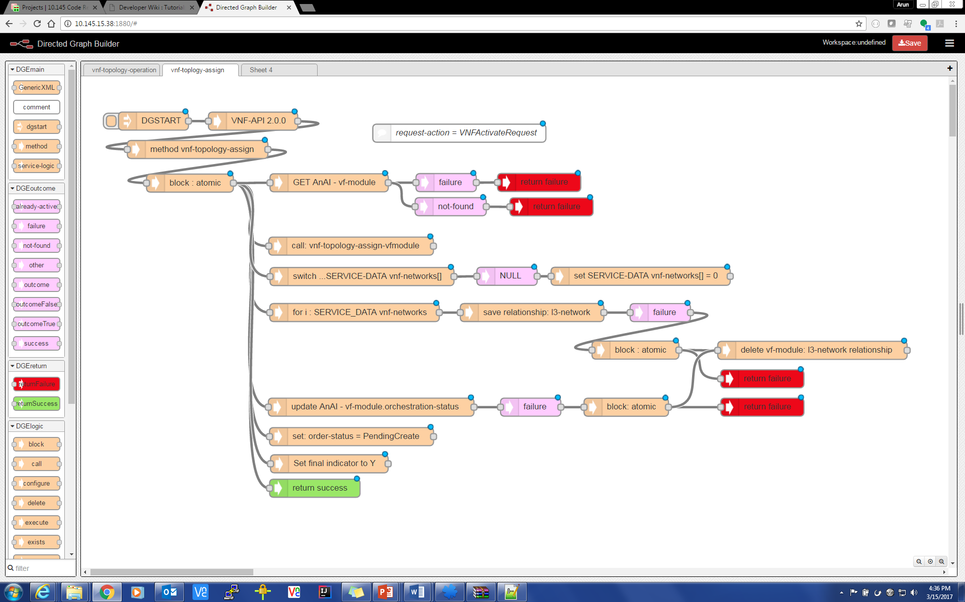
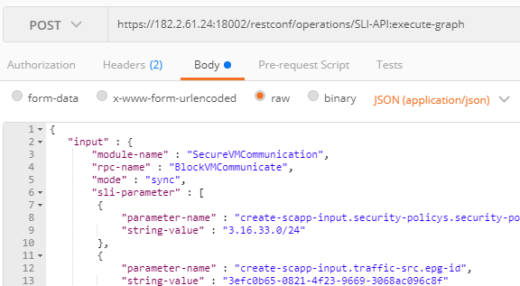
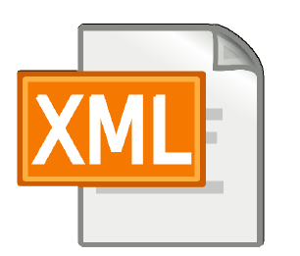
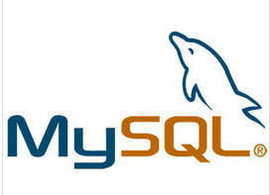
DG/SLI Design Time/ Run Time
Design Time
NB Client
RunTime
JSON/XML
DG Builder
RESTCONF API
Generic Resource API
VNF API
SLI-API
DG
SLI Compiler
DG Database
SLI Interpreter
Plugins/Adapters
REST Adapter
RESTCONF Adapter
RuntimeRpcNode
DG Builder
O/P
GetDG
SLI Interpreter
JAVA Object
RESTCONF
SvcLogic
Parser
JAVA Object
JSON/XML
DG Object

Slide 12
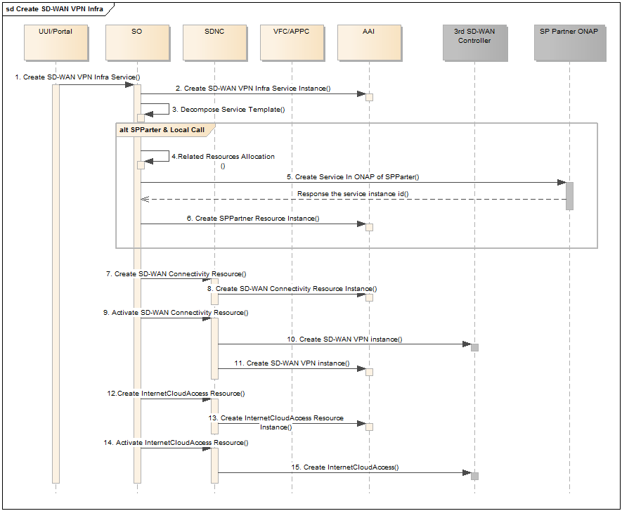
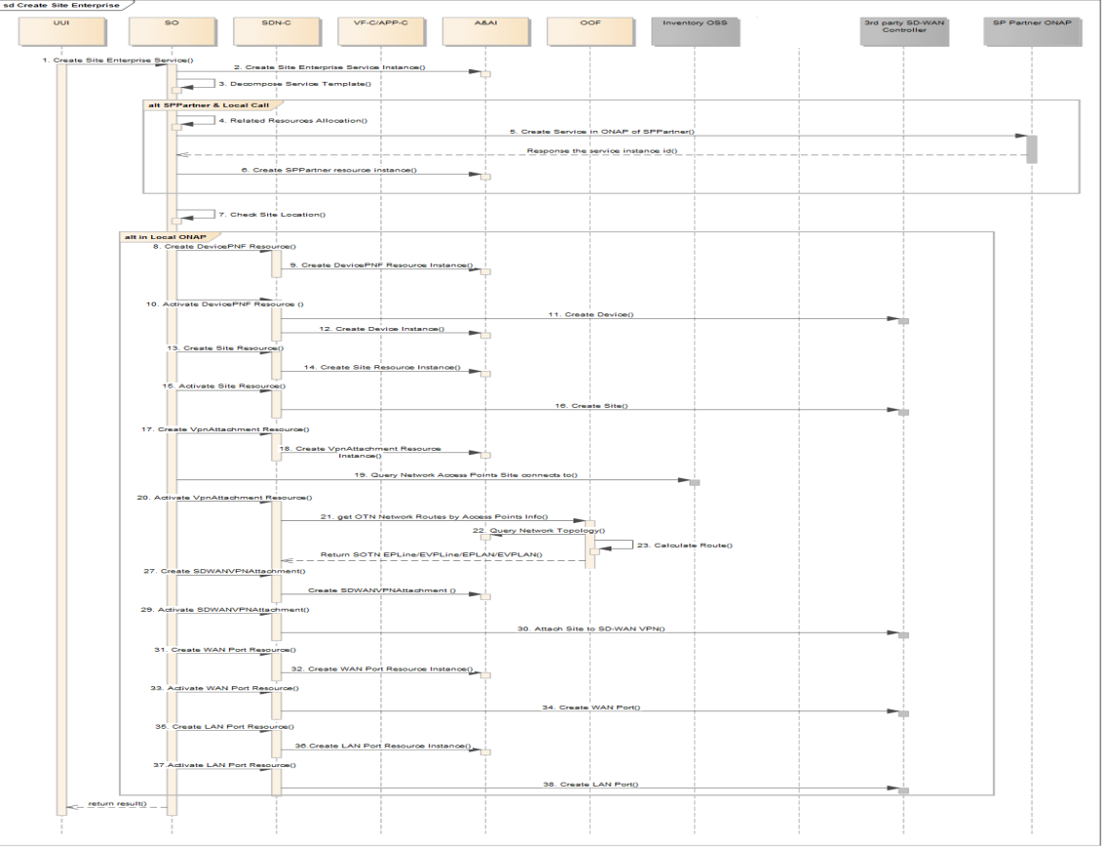
Call Flows
Note: POSTMAN will be used in demo to simulate request from SO and so demo won’t include Portal and SO

Slide 13
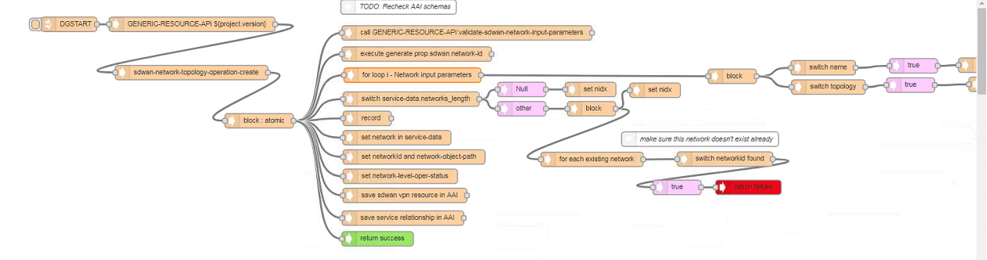
SD-WAN DG
Each SDN-C NBI API is associated with a DG to hide the difference of northbound API of various vendor’s controller

